Slide 1


ECEN 404
Bi-Weekly Update 5
Matrix 1 / “Scooter Juice”
Connor Cottongame
John Dusterhoff
Blake Hallam
Oscar Rubio
TA: Sabyasachi Gupta
Sponsor: Prof Prasad Enjeti

Slide 2

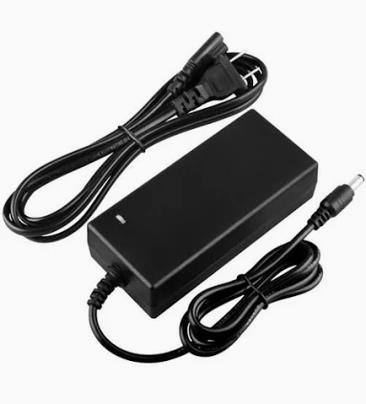

Project Summary
Problem statement:
Current electric scooter chargers are bulky and inconvenient to use, requiring large, external rectifiers to charge their batteries, much like a laptop charger.
Our Solution:
This team will design and build an IOBC (Integrated On-Board Charger), allowing the scooter to be charged directly from an AC power source.
This charger will use the existing inverter components in the scooter as a rectifier in order to charge the battery.

Slide 3
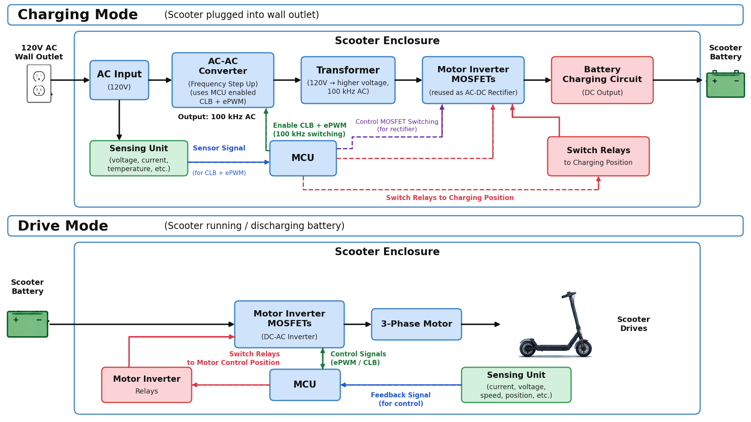
Integrated System Diagram

Slide 4
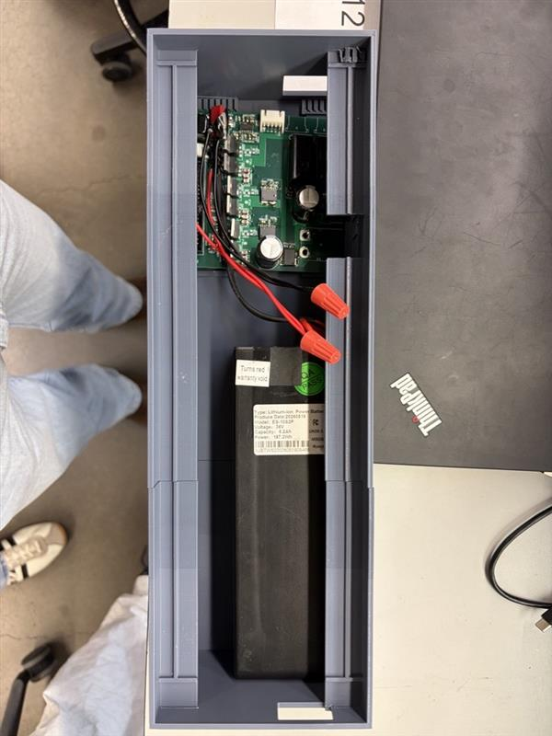
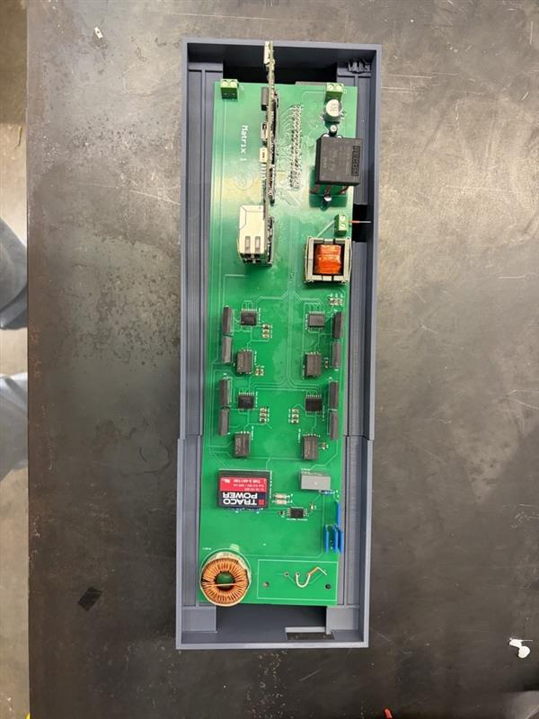
Integrated System Diagram
Motor Output Cable Slots
Secondary Side PCB
Primary Side PCB
Scooter Battery
Charger Wall Cable
Enclosure underneath primary PCB
Top part of enclosure with primary PCB

Slide 5
Project Timeline
Subsystem Designs and Updated and necessary testing (completed by 9/14) | Final subsystem testing and start integration (completed by 9/28) | Integration of MCU, signal processing and power stages (complete by 10/1) | Final Integration (to complete by 10/22) | Full System Testing (to complete by 11/5) | Full System Validation (to complete by 11/12) | Demo and Report (to complete by 12/5)
Completed:
In Progress:
Behind Schedule:

Slide 6
Primary PCB (Signal Processing and Matrix Converter)
Blake Hallam
Accomplishments since update 4 10 hrs of effort | Ongoing progress/problems and plans until the next presentation
Fully assembled PCB with components. Tested and validated wall side signal processing at wall voltage. Tested and the transformer with input from the MOSFET matrix. Fully integrated with both Oscar and John | Integration with Connor’s subsystem Continue validating transformer Measuring exact voltage from Differential amplifier output

Slide 7
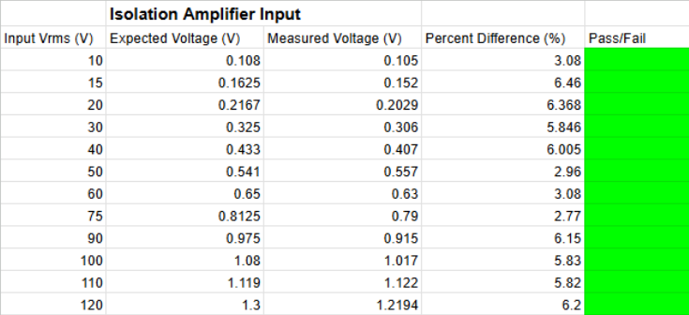
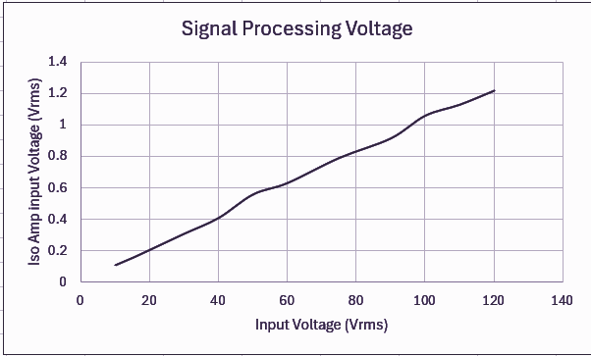
Primary PCB (Signal Processing and Matrix Converter)
Blake Hallam

Slide 8
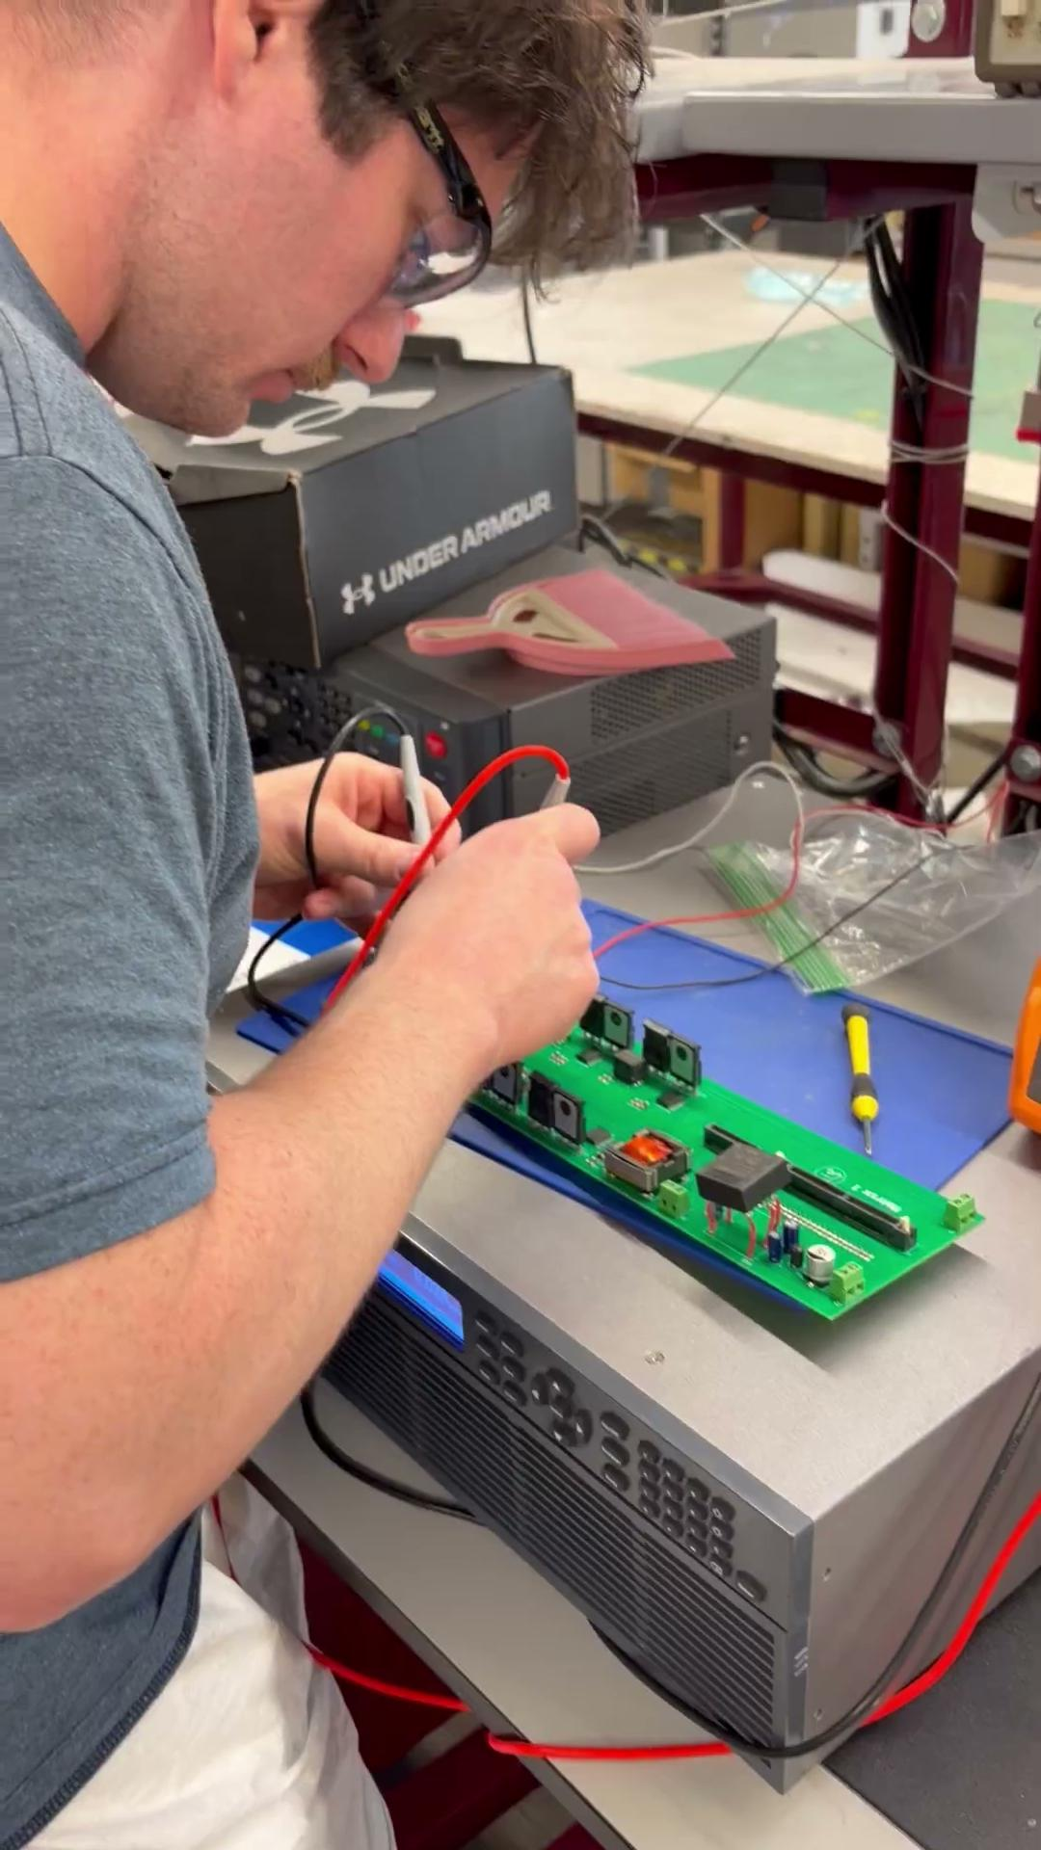
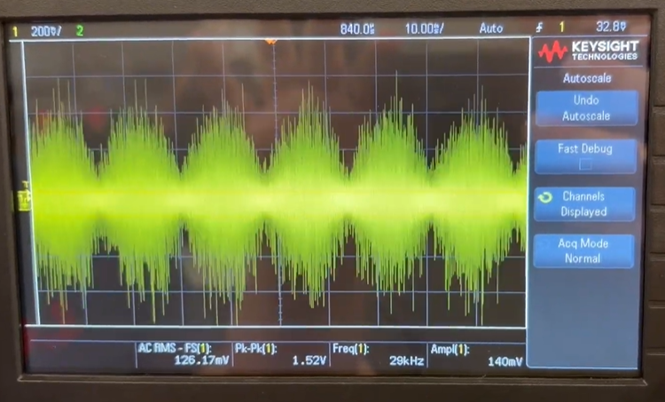
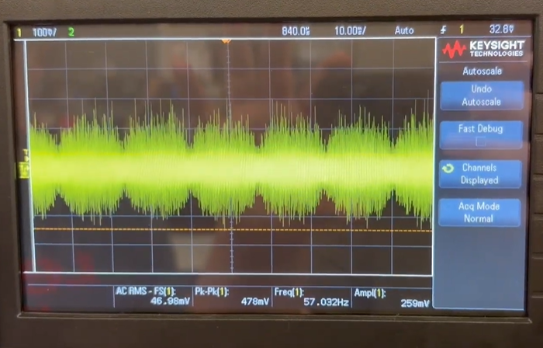
Primary PCB (Signal Processing and Matrix Converter)
Blake Hallam

Slide 9
Primary PCB and Enclosure
Oscar Rubio
Accomplishments since update 4 12 hrs of effort | Ongoing progress/problems and plans until the next presentation
Completed testing and validation on the control signal with ADC input voltage ranges. Validated controlCard firmware function and fully integrated with Blake and John Validated ControlCard temperature was within specified range in the FSR with John Rev 1. of scooter enclosure was 3D printed Completed VPS sign-up | Measuring exact output voltage from the differential amplifier and adjusting the ADC code as necessary Continue full primary PCB validation Integration with Secondary Side PCB 3D printing Rev. 2 of the scooter enclosure

Slide 10
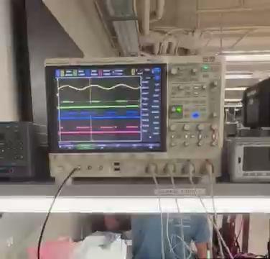
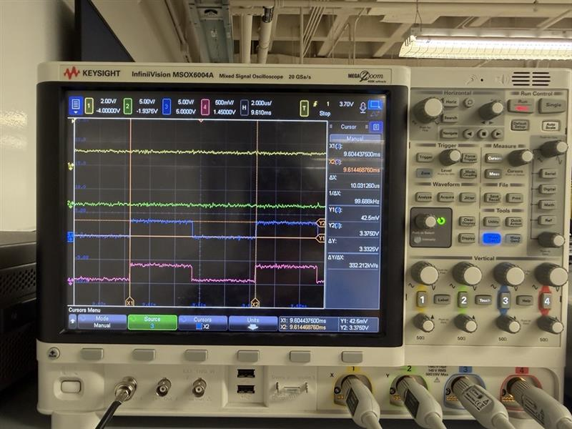
Primary PCB and Enclosure
Oscar Rubio
Image from ADC input voltage range testing on Control Signal at Vpp = 1.0V
Image from ADC input voltage range testing on Control Signal at Vpp = 2.0V

Slide 11
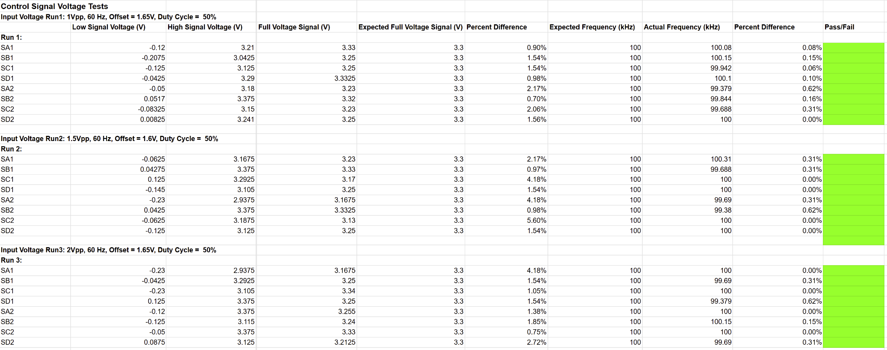
Primary PCB and Enclosure
Oscar Rubio
Results from ADC input voltage range testing on Control Signal

Slide 12
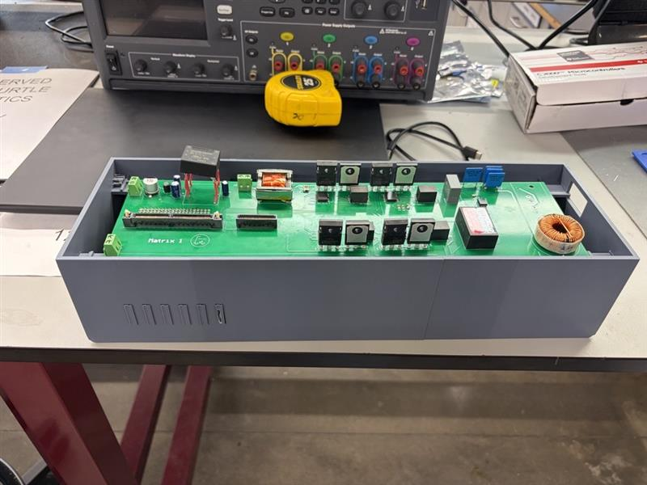
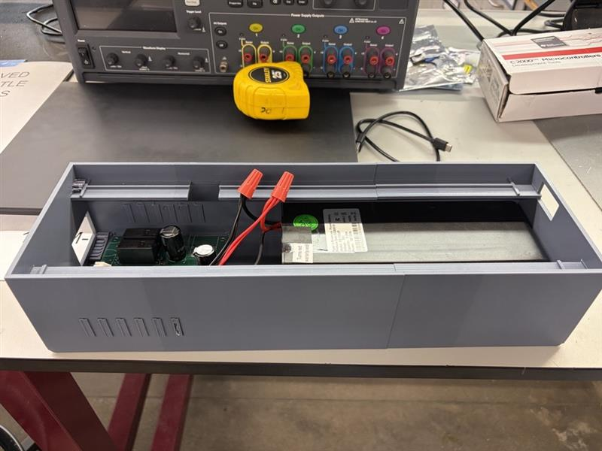
Primary PCB and Enclosure
Oscar Rubio
Enclosure Current Dimension: 370mmx120mmx80mm
Rev 2 Dimensions: 370mmx120mmx130mm

Slide 13
Primary PCB
John Dusterhoff
Accomplishments since update 4 14 hrs of effort | Ongoing progress/problems and plans until the next presentation
Validated operating temperatures for primary PCB components, all staying under 30C Primary PCB soldered and full system tested Validated controlCard switching and signal integrity Validated power received by controlCard | Fully validating Primary PCB Running primary board off battery power, testing average draw from Primary PCB off battery Integration with Secondary PCB Integration with both PCBs into enclosure

Slide 14
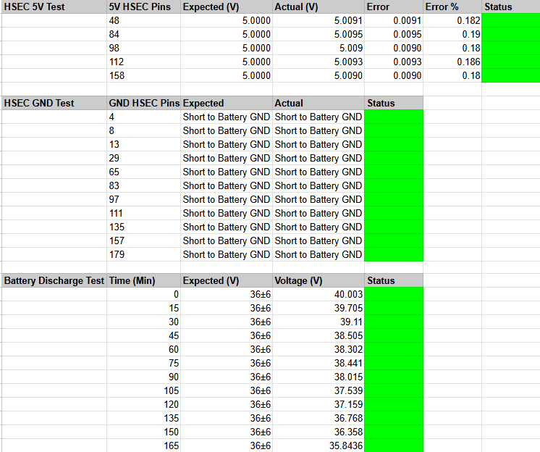
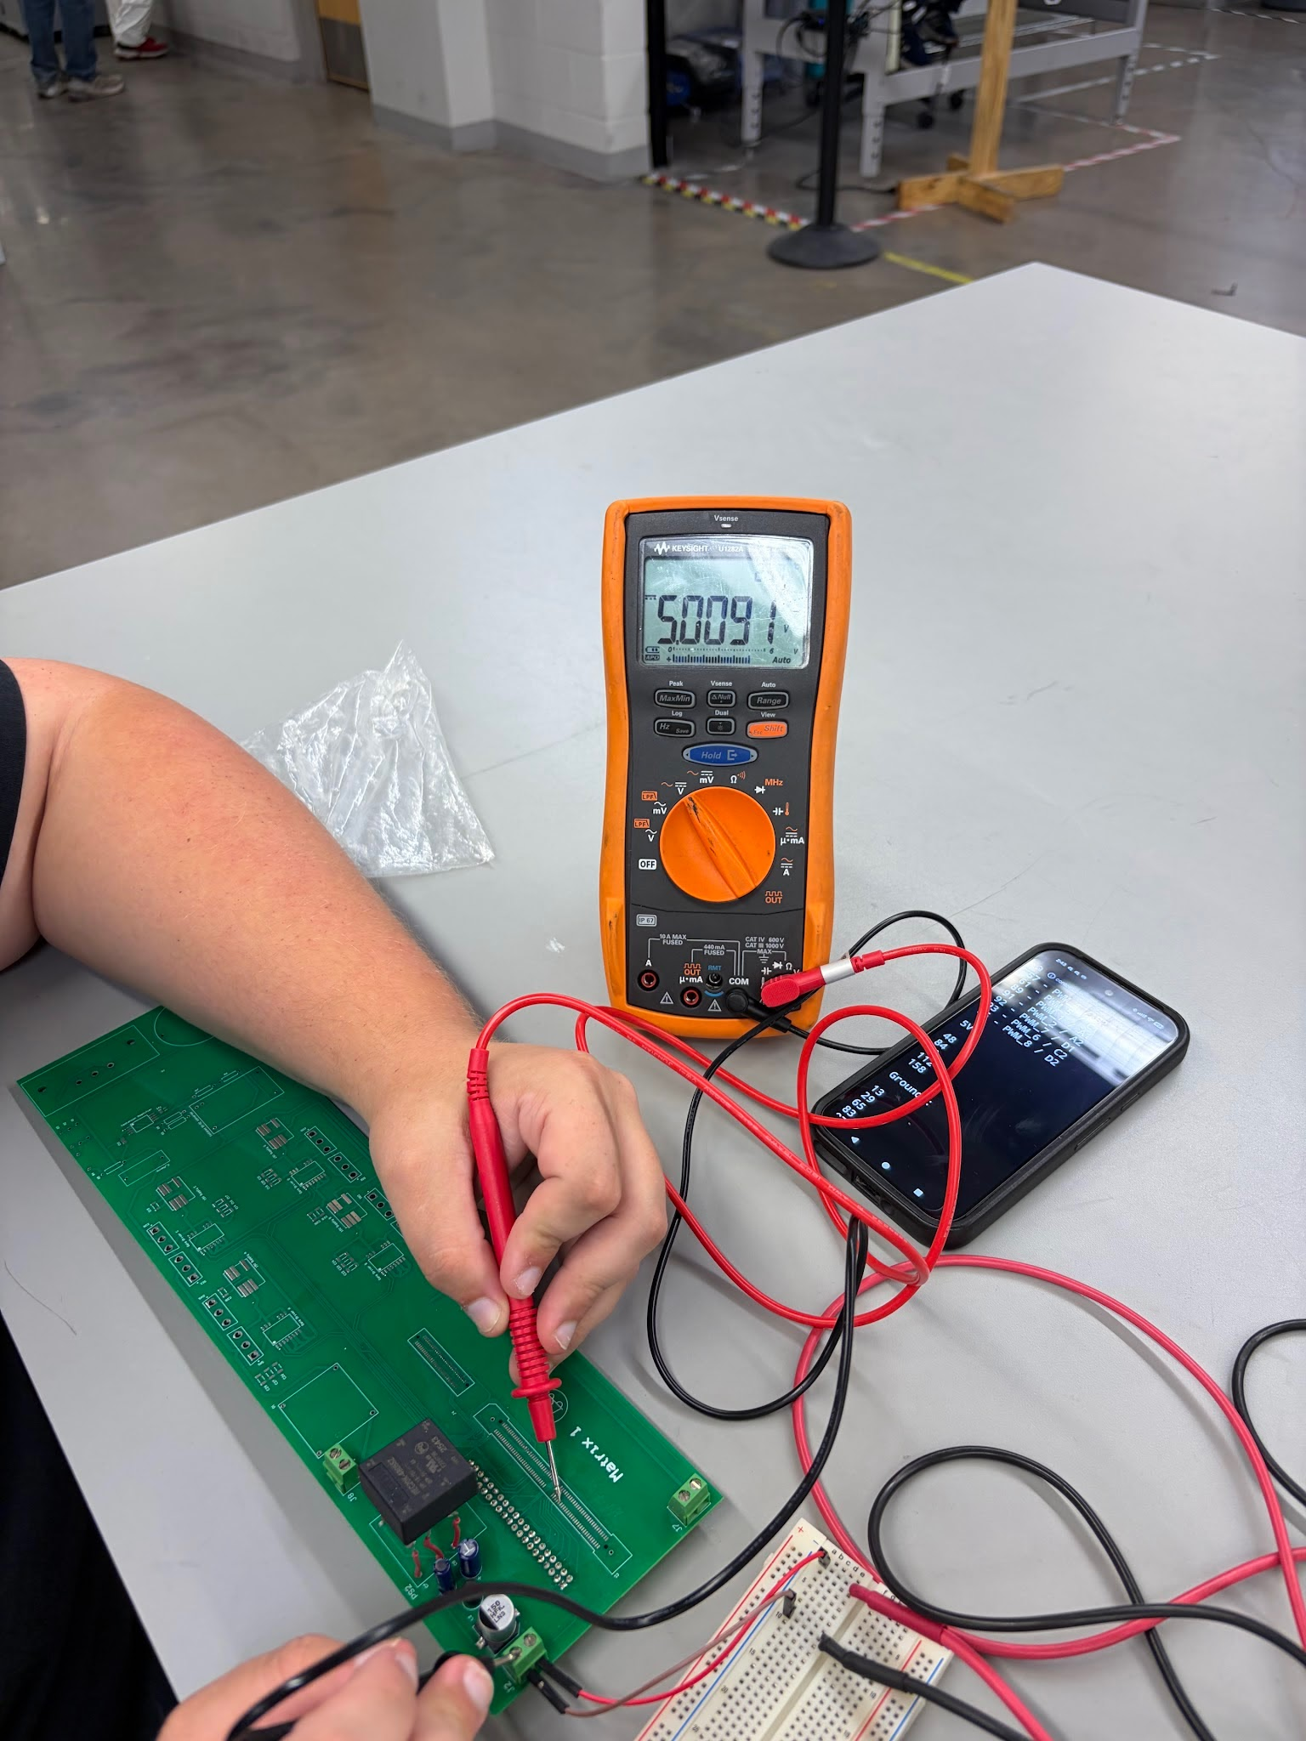
Primary PCB
John Dusterhoff
5V pin testing on HSEC connector
Power Pin Voltage Testing, 5V and GND
pins, as well as Battery discharge voltages

Slide 15
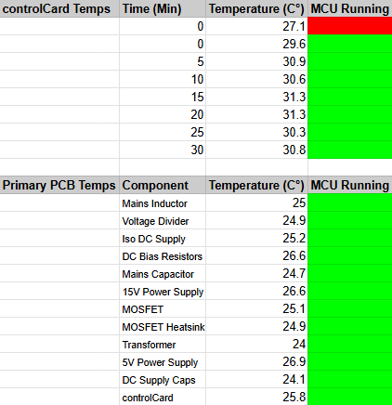
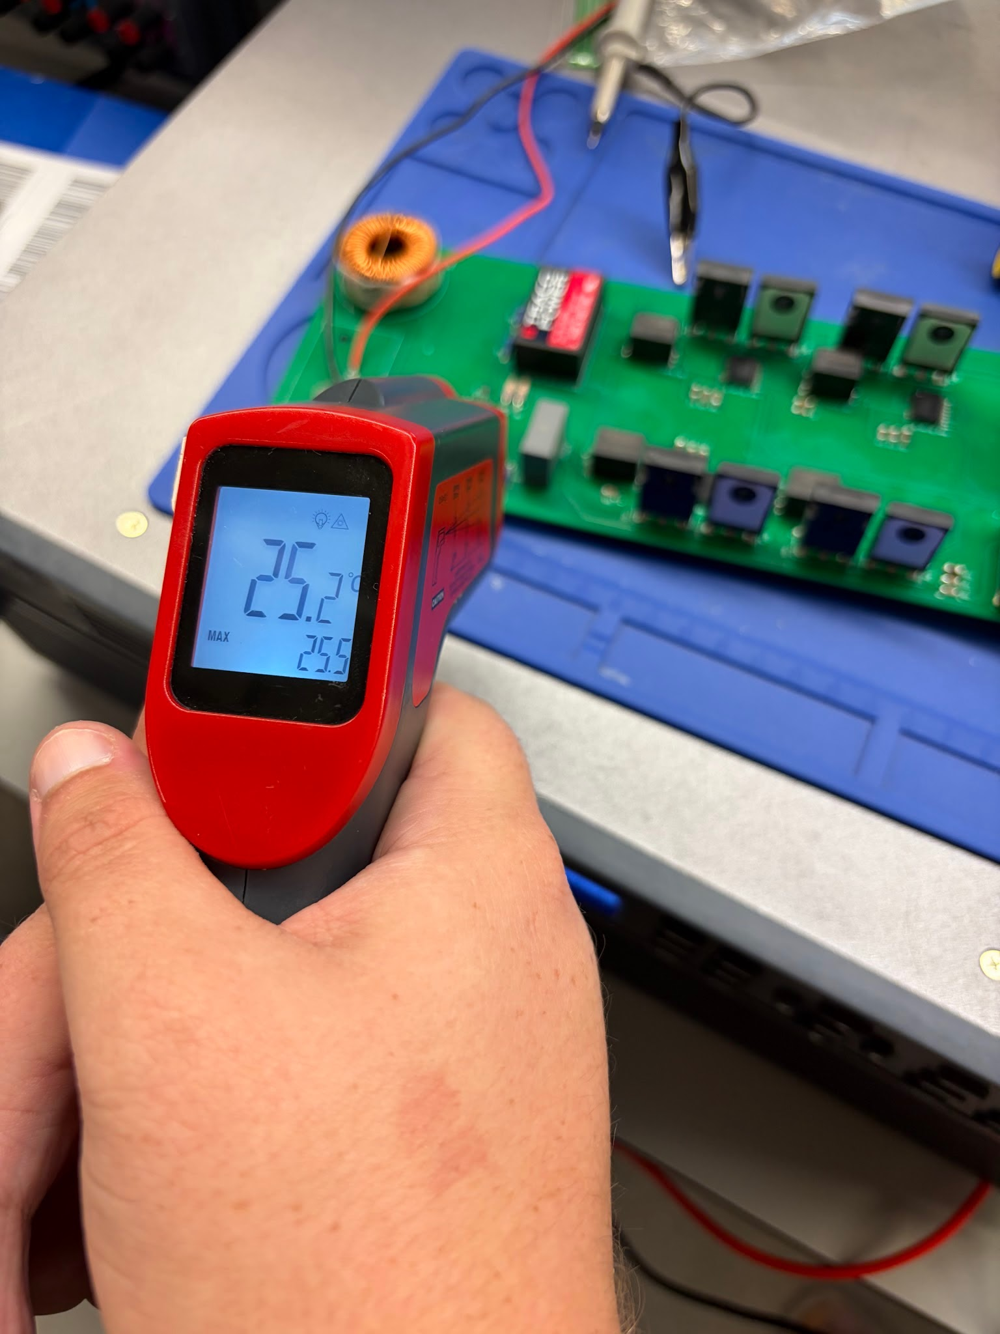
Primary PCB
John Dusterhoff
Temperature readings from various components, as well as the controlCard over time
Temperature testing setup, board running with a temperature gun reading the Isolated DC Supply

Slide 16
Secondary PCB: Motor Drive, Battery Charger, Control Firmware
Connor Cottongame
Accomplishments since update 4 12 hrs of effort | Ongoing progress / problems and plans until the next presentation
Secondary PCB fully assembled and powered: 43 of 47 tests run so far pass Validated on-board supplies: 12 V = 11.99 V, 3.3 V = 3.28 V, sensor 5 V = 5.04 V; 5 V supply repaired Validated battery-voltage measurement over the full battery range (30–42 V): ≤ 0.41 % error, spec 1 % Validated standby power: 24 mA at 36 V Validated 2 of 3 current sensors at zero current Found and fixed 4 soldering defects; located the remaining 2 Control software ready: control loop runs in 4.2 µs of its 50 µs budget, on the same processor as the team controller | Repair one current-sensor trace and the motor-position sensor connection to the controller cable Test the charge/drive relays and power-transistor drivers; check switching on the oscilloscope Spin the motor from the board; test the over-current shutdown Build the charger test bench and transfer 70 W through it Integration checks, then connect to the primary board (plan on next slides)
Notes:
Since update 4 the board went from bare PCB to powered and mostly validated. This one board is both the motor drive and the battery side of the charger, and it powers the whole system. If you have the re-measured 5 V reading, say it.

Slide 17
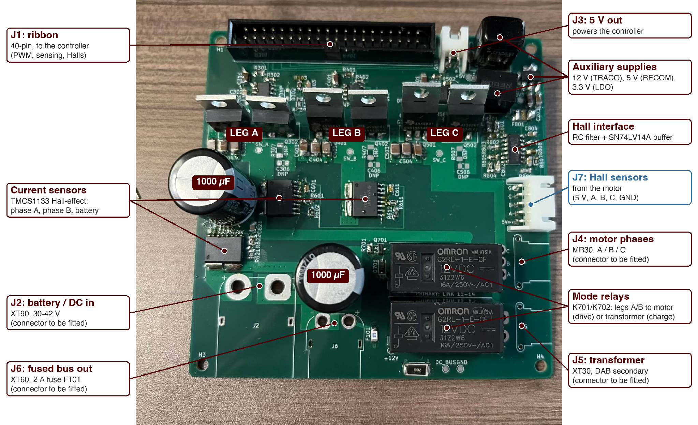
Secondary PCB
126 total parts: 3 power-switching legs, 2 operating modes
Notes:
Three switching legs drive the motor, and two of them double as the battery side of the charger; the relays pick which. Current sensors, battery-voltage sensing and the motor's position sensors all feed the controller through the 40-pin cable. The on-board supplies run everything, including the controller, from the battery.

Slide 18
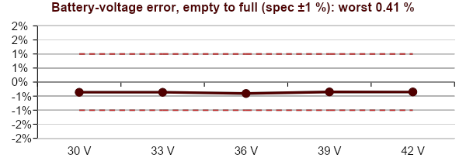
Subsystem Validation Progress
Board tests by stage (122 total)
Key test (36 V input) | Criterion | Measured | Result
12 V supply | 12 V ± 5 % | 11.99 V | PASS
5 V supply | 5 V ± 5 % | Repaired | PASS
3.3 V supply | 3.3 V ± 3 % | 3.28 V | PASS
Battery voltage, 30–42 V | Error ≤ 1 % | ≤ 0.41 % | PASS
Standby current at 36 V | ≤ 50 mA | 24 mA | PASS
Battery current sensor | Reads zero | Zero | PASS
Motor current sensor B | Reads zero | Zero | PASS
Motor current sensor A | Reads zero | No output | OPEN
Motor position sensors | Reach controller | No signal | OPEN
Visual inspection
6
Unpowered checks
21
21
First power-up
16
4
3
Mode relays
6
Transistor drivers
19
With controller
12
Switching (scope)
14
Pass 43
Open 4
Not yet run 75
4 defects found and fixed: two current-sensor solder joints, an open resistor, the 5 V supply module
Open, fixing this week: damaged trace on current sensor A (wire jumper); open connection between the position-sensor circuit and the controller cable (trace and resolder)
All faults are hand-soldering defects; no design errors found so far.
Notes:
Every test run so far passes except four, and all four come from two physical faults with known locations. The battery-voltage sweep covers empty to full with 2.4x margin on the spec; the charger uses this signal to stop at 41 V. The remaining stages need the relays and controller attached and start once the two faults are closed.

Slide 19
Integration Test Conditions
Connor Cottongame
Stage 1: charger test bench (before connecting to the team board)
Stage 2: full system with the team primary board
Test controller
same processor as team's
40-pin control cable
Team controller
drives both boards
40-pin control cable
40 V bench supply
isolated, current-limited
Test primary
2nd copy of my board
Test transformer
+ series inductor
Secondary PCB
my board
120 V AC wall
ramped up from low voltage
Team primary
AC-to-AC converter
Transformer
isolation
Secondary PCB
my board
Hub motor
drive mode
Battery or resistor
30–42 V
Hub motor
drive mode
Scooter battery
30–42 V
Proves 70 W power transfer and battery charging with known-good hardware on both sides.
Same secondary board and software; only the source side changes.
Notes:
Stage 1 proves my board's power stage on a test bench I control, using a second copy of my board as a stand-in primary. Stage 2 swaps in the team's primary board and wall power; the secondary board and software stay the same.

Slide 20
System Validation Plan: Subsystem-Level
Connor Cottongame
Tests the secondary board passes on its own before it is connected to the team's primary board.
ID | Validation test | Req. | Success criteria | Method / test conditions | Owner | Status
E1 | Secondary board bring-up | 8.2.3.1.4, 8.2.1.12 | All supplies within ±5 %; battery-voltage error ≤ 1 %; all 122 board tests pass | Step-by-step test procedure on a current-limited 30–42 V bench supply | Connor | 43 / 47 PASS
E2 | Power-transistor switching | 8.2.1.8 | Transistors switch cleanly with a safe gap between on and off; voltage spikes < 80 V at 36 V | Controller drives each leg; oscilloscope on each switch, resistor load | Connor | NOT STARTED
E3 | Motor drive and over-current shutdown | 8.2.1.10, 8.2.5.1.1.1 | Position sensors read in order; wheel spins at ≤ 5 A; over-current stops switching < 1 ms | Hub motor on the bench; shutdown limit set low for the test | Connor | NOT STARTED
E4 | Charger power transfer (test bench) | 8.2.1.1 | ≈ 70 W delivered; within 10 % of the simulation model | Stage 1 test bench: 40 V supply, test transformer, resistor load | Connor | NOT STARTED
Notes:
Validation plan from the point of view of integrating my board with the primary board. Entry checks prove my side first; the scenarios then exercise the whole system the way a rider would use it.

Slide 21
System Validation Plan: Integration
Connor Cottongame
Full system validation tests that involve secondary board
ID | Validation test | Req. | Success criteria | Method / test conditions | Status
V1 | Control cable interface | ICD | Every control and sensor signal arrives at the right pin and level; outputs stay off by default | Continuity check unpowered, then controller at low voltage | NOT STARTED
V2 | Battery-only system power | 8.2.3.1.4 | Battery alone powers both boards and the controller (no USB or bench supply) | Battery connected; check start-up and every supply | NOT STARTED
V3 | Ride (drive mode) | 8.2.1.10 | Controller spins the wheel using the position sensors; motor current ≤ 5 A | Battery power, throttle command, measure motor current | NOT STARTED
V4 | Charge/drive switch-over | 8.2.1.14 | Relays switch only while all switching is stopped; motor can't run while charging | Change mode during operation; log relay timing | NOT STARTED
V5 | Charge at reduced AC | 8.2.1.1 | Power reaches the secondary load within 10 % of the model | Isolated low-voltage AC, resistor load, power slowly increased | NOT STARTED
V6 | Wall charge into the battery | 8.2.1.7 | 120 V AC charges the battery at ≤ 1.5 A and stops at 41 V | Full system in the enclosure; log battery voltage and current | NOT STARTED
V7 | Fault response | 8.2.5.1.1.1 | Over-current or loss of AC stops all switching on both boards < 1 ms; safe restart | Trigger over-current with a low limit; unplug AC mid-charge | NOT STARTED
Notes:
Validation plan from the point of view of integrating my board with the primary board. Entry checks prove my side first; the scenarios then exercise the whole system the way a rider would use it.

Slide 22
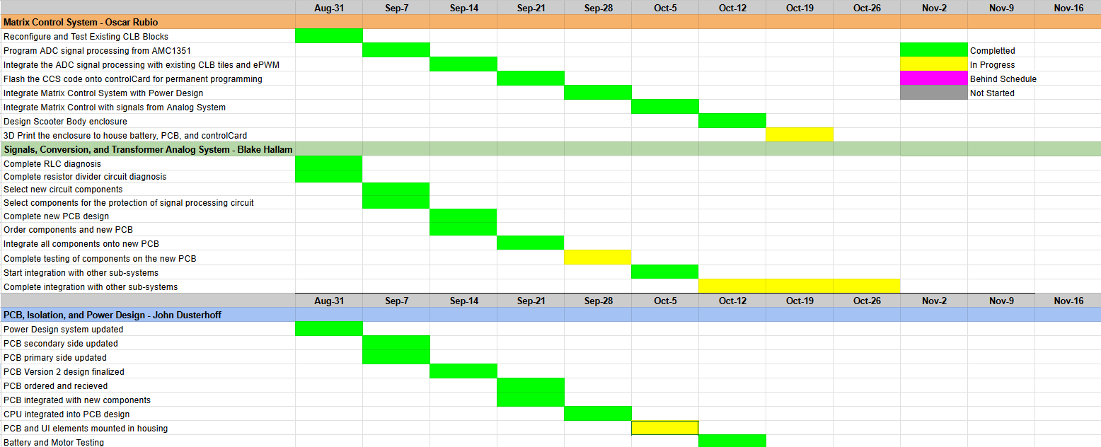
Execution Plan

Slide 23
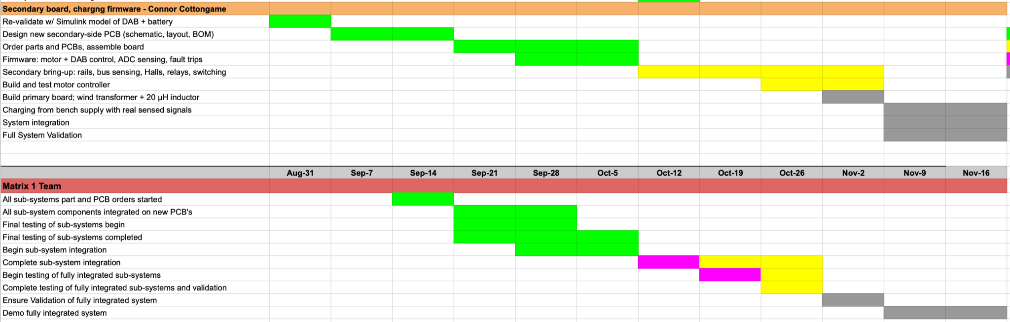
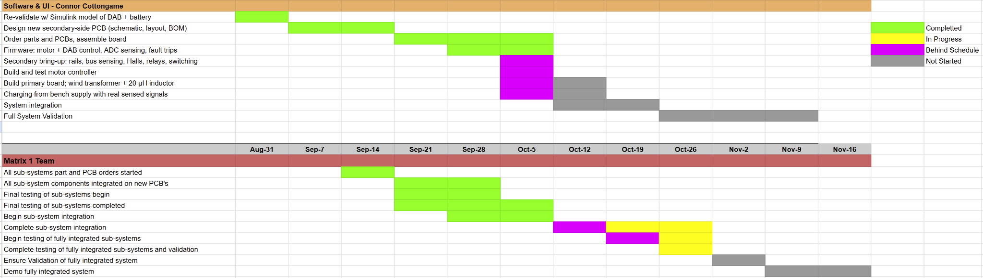
Execution Plan

Slide 24
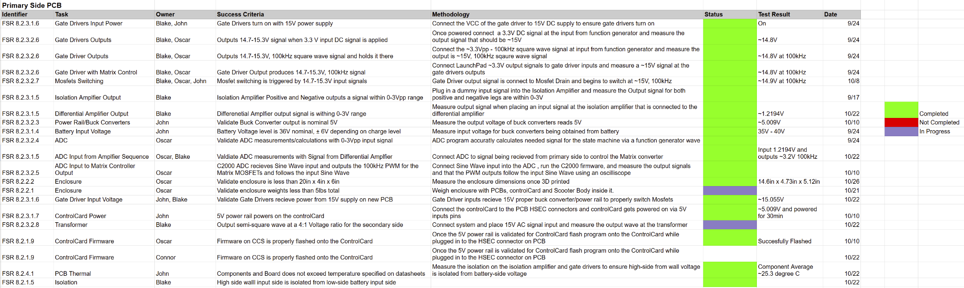
System Validation Plan

Slide 25
Thank You For Your Time and Attention
Any Questions?
Matrix 1 / “Scooter Juice”
Connor Cottongame
John Dusterhoff
Blake Hallam
Oscar Rubio
TA: Sabyasachi Gupta
Sponsor: Prof Prasad Enjeti

